Slide 1
Deep Learning Shallow vs Deep
Understanding Machine Learning

Slide 2

Recap: Goal of ML
generalization from optimization on training data set (approximation of true data generating probability distribution by empirical risk minimization)
fitting: complex function approximation
for generalization: learning of good abstraction/representation of data/concepts
→ deep learning methods (MLP, CNN, …) optimal candidates
e.g., CNNs can learn hierarchical representation by means of many convolutional and pooling layers
the deeper the better (accuracy, hierarchical representation)
source

Slide 3
Deep Learning

Slide 4

But … How to Train Deep Neural Networks?
optimization and regularization difficult
non-convex optimization problem (e.g., local vs global minima, saddle points), easily overfitting
many hyperparameters to tune
many methods to get it working in practice (despite partly patchy theoretical understanding)
typical loss surface:
source
optimization
activation and loss functions
weight initialization
stochastic gradient descent
adaptive learning rate
batch normalization
explicit regularization
weight decay
dropout
data augmentation
weight sharing
implicit regularization
early stopping
batch normalization
stochastic gradient descent

Slide 5


History: Rise of Deep Learning
a little bit oversimplified:
deep learning = lots of training data + parallel computation + smart algorithms
AlexNet: ImageNet (with data augmentation) + GPUs + ReLU, dropout, SGD
source

Slide 6
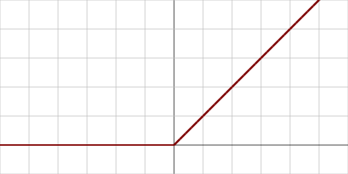
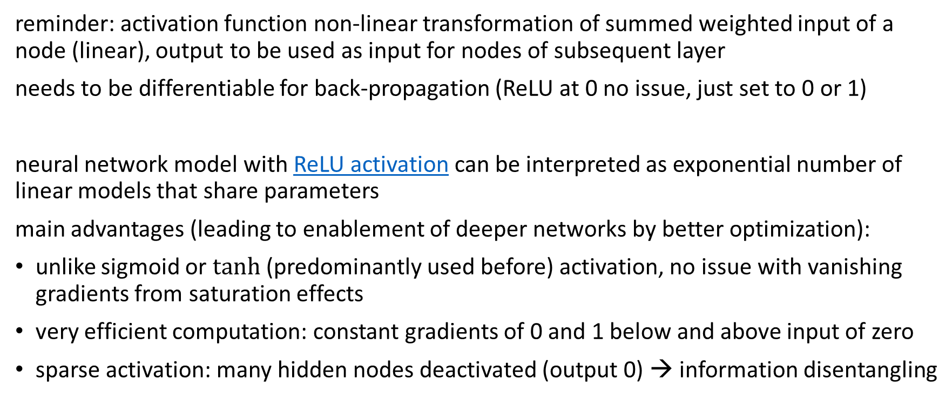
Rectified Linear Unit (ReLU)
reminder: activation function non-linear transformation of summed weighted input of a node (linear), output to be used as input for nodes of subsequent layer
needs to be differentiable for back-propagation (ReLU at 0 no issue, just set to 0 or 1)
neural network model with ReLU activation can be interpreted as exponential number of linear models that share parameters
main advantages (leading to enablement of deeper networks by better optimization):
unlike sigmoid or $tanh$ (predominantly used before) activation, no issue with vanishing gradients from saturation effects
very efficient computation: constant gradients of 0 and 1 below and above input of zero
sparse activation: many hidden nodes deactivated (output 0) → information disentangling

Slide 7
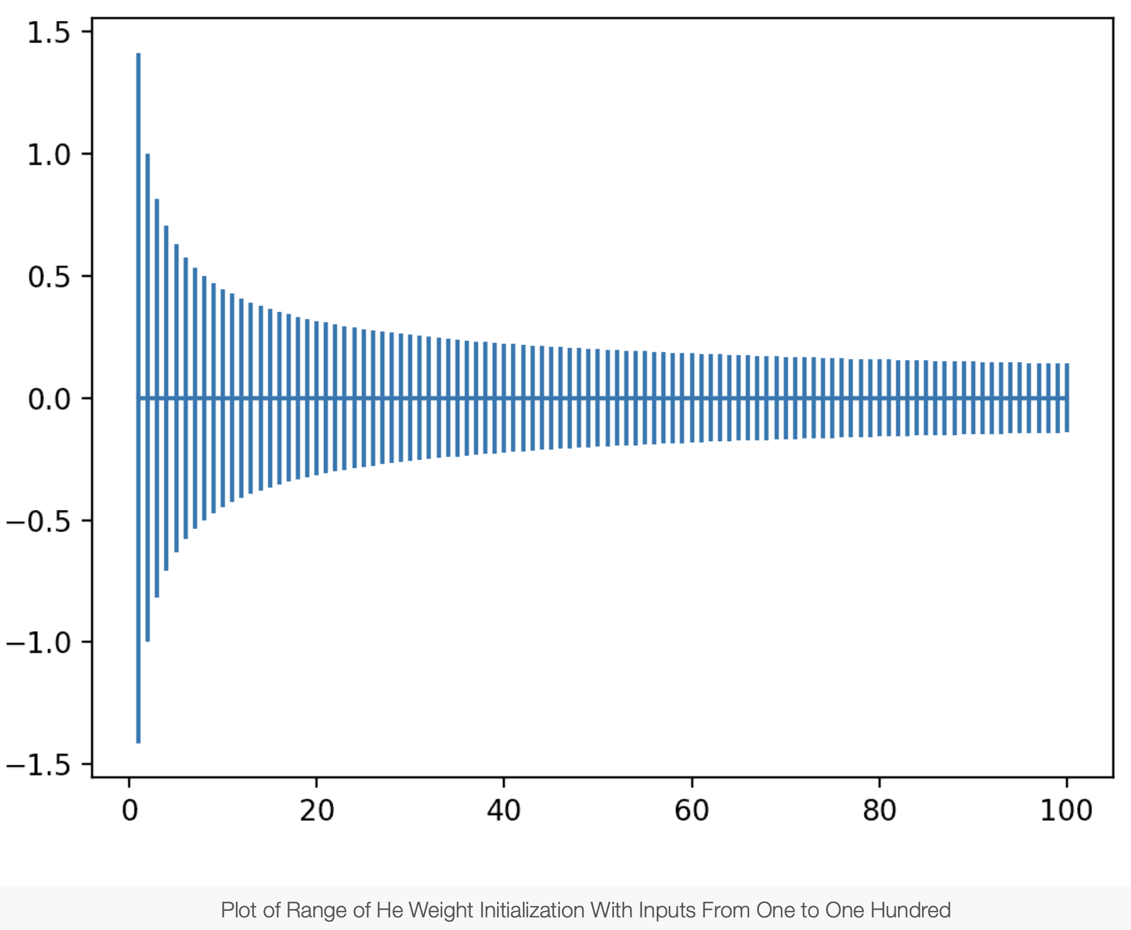
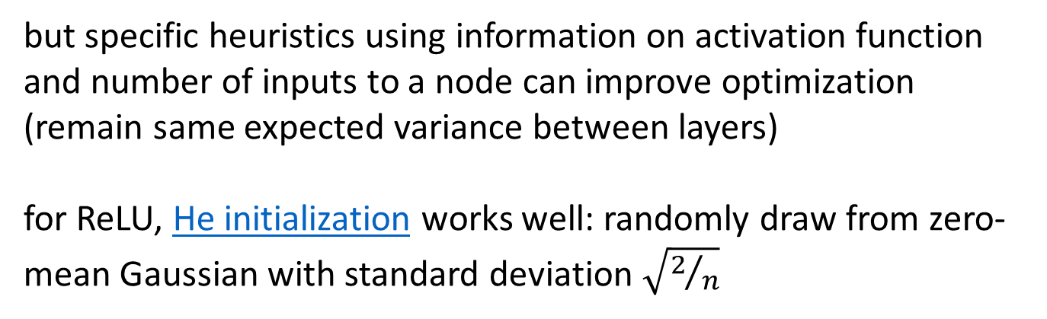
Weight Initialization
starting values for weights crucial for convergence of deep learning trainings
most important: need to break symmetry between different nodes in a hidden layer (same initial weights lead to identical weight updates) ← early issue in back-propagation
→ small random numbers (from Gaussian or uniform distribution) work (only bias weights set to zero by default)
but specific heuristics using information on activation function and number of inputs to a node can improve optimization (remain same expected variance between layers)
for ReLU, He initialization works well: randomly draw from zero-mean Gaussian with standard deviation $\sqrt{2/n}$
number of inputs (hidden nodes in previous layer)
source

Slide 8
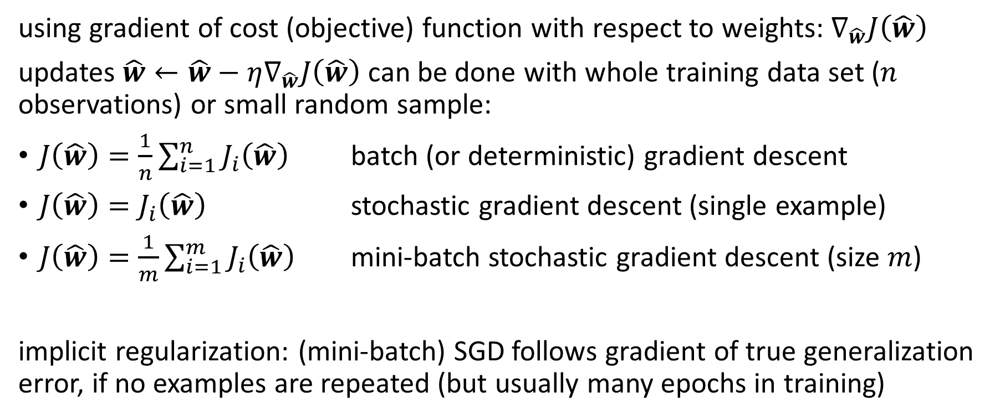
(Stochastic) Gradient Descent
using gradient of cost (objective) function with respect to weights: $∇_{\hat{w}}J\left(\hat{w}\right)$
updates $\hat{w}←\hat{w}−η∇_{\hat{w}}J\left(\hat{w}\right)$ can be done with whole training data set ($n$ observations) or small random sample:
$J\left(\hat{w}\right)=\frac{1}{n}\sum_{i=1}^{n}{J_{i}\left(\hat{w}\right)}$ batch (or deterministic) gradient descent
$J\left(\hat{w}\right)=J_{i}\left(\hat{w}\right)$ stochastic gradient descent (single example)
$J\left(\hat{w}\right)=\frac{1}{m}\sum_{i=1}^{m}{J_{i}\left(\hat{w}\right)}$ mini-batch stochastic gradient descent (size $m$)
implicit regularization: (mini-batch) SGD follows gradient of true generalization error, if no examples are repeated (but usually many epochs in training)

Slide 9
Mini-Batch Sizes
trade-off:
larger batches give more accurate gradient estimates → allowing for higher learning rate
smaller batches have (implicit) regularization eﬀect and better convergence
in practice, also need to consider memory limitations and run times

Slide 10
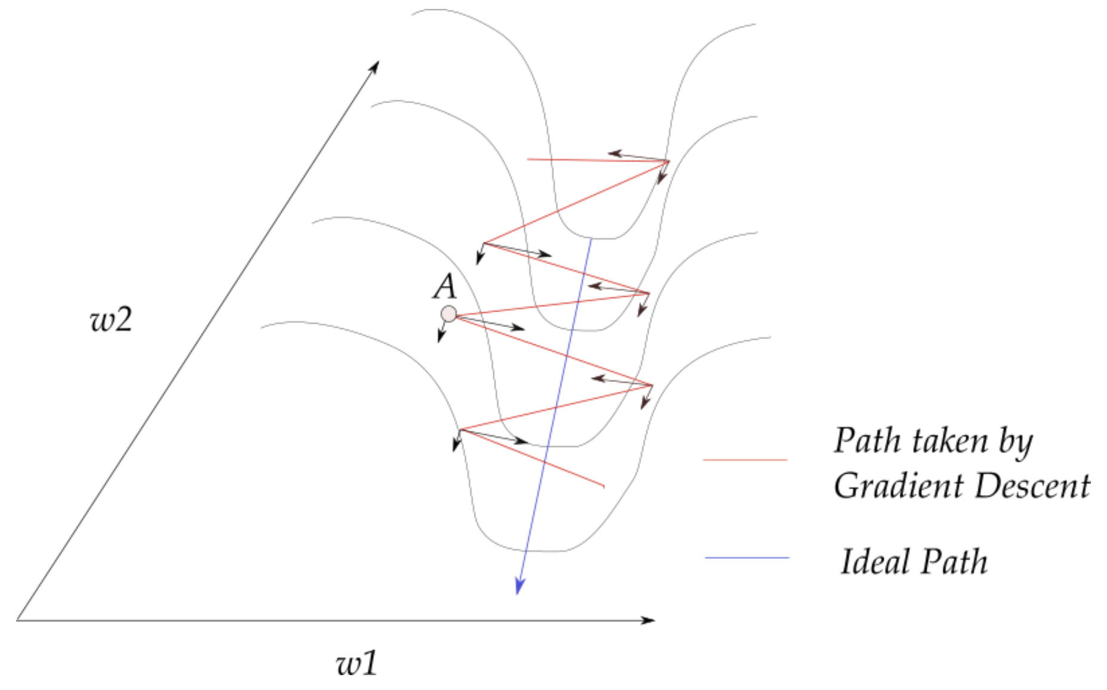
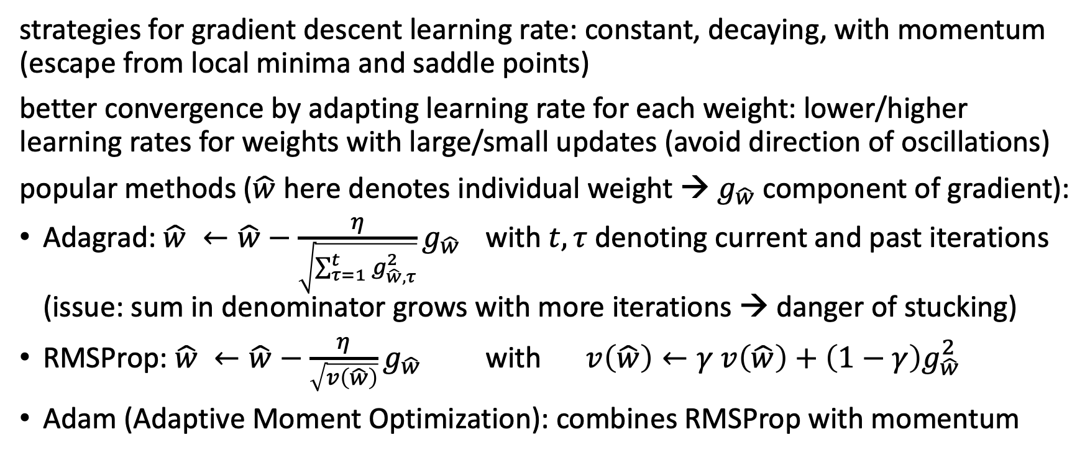
Adaptive Learning Rate
source
strategies for gradient descent learning rate: constant, decaying, with momentum (escape from local minima and saddle points)
better convergence by adapting learning rate for each weight: lower/higher learning rates for weights with large/small updates (avoid direction of oscillations)
popular methods ($\hat{w}$ here denotes individual weight → $g_{\hat{w}}$ component of gradient):
Adagrad: $\hat{w} ←\hat{w}−\frac{η}{\sqrt{\sum_{τ=1}^{t}{g_{\hat{w},τ}^{2}}}}g_{\hat{w}}$ with $t, τ$ denoting current and past iterations (issue: sum in denominator grows with more iterations → danger of stucking)
RMSProp: $\hat{w} ←\hat{w}−\frac{η}{\sqrt{v\left(\hat{w}\right)}}g_{\hat{w}}$ with $v\left(\hat{w}\right)←γ v\left(\hat{w}\right)+\left(1−γ\right)g_{\hat{w}}^{2}$
Adam (Adaptive Moment Optimization): combines RMSProp with momentum

Slide 11
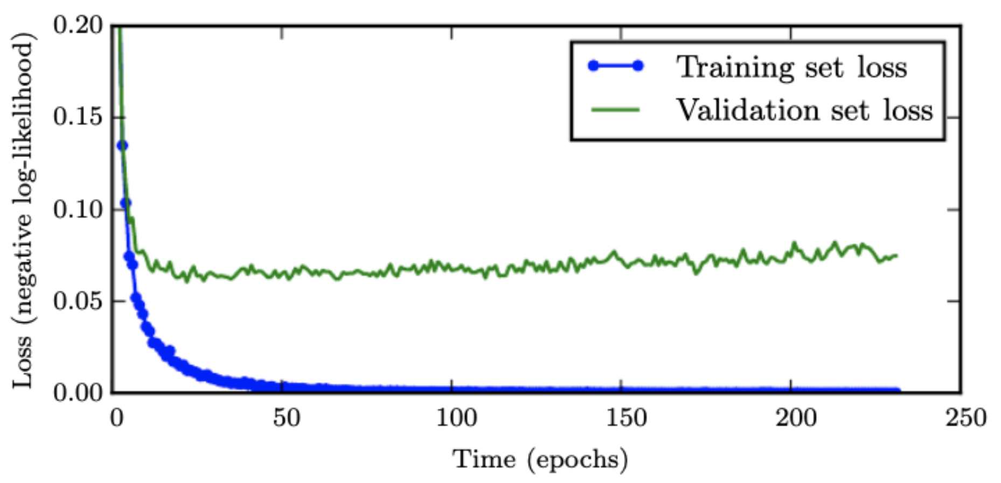
Early Stopping
loss independently measured on validation set
halting training when overﬁtting begins to occur
early stopping
(suppresses double descent)
source

Slide 12


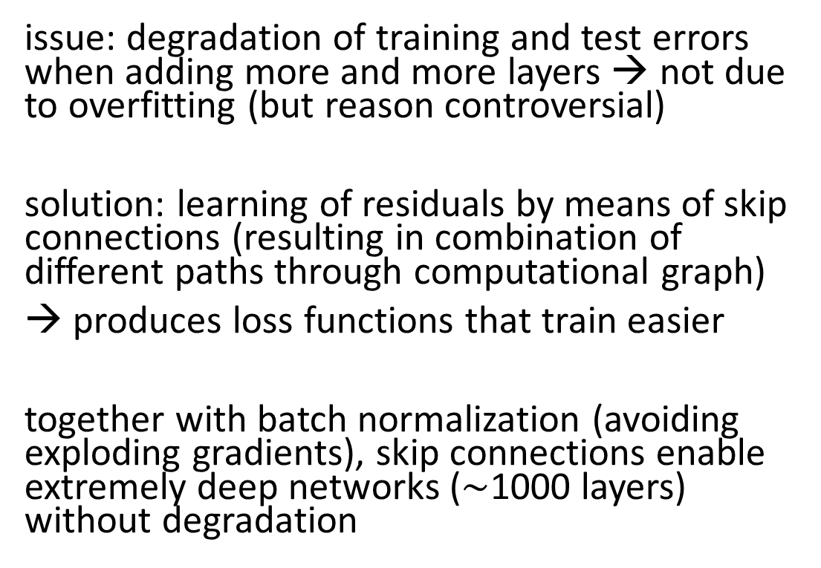
Skip/Residual Connections
residual mapping (skip/shortcut connections):
ResNet
issue: degradation of training and test errors when adding more and more layers → not due to overfitting (but reason controversial)
solution: learning of residuals by means of skip connections (resulting in combination of different paths through computational graph)
→ produces loss functions that train easier
together with batch normalization (avoiding exploding gradients), skip connections enable extremely deep networks ($\sim$1000 layers) without degradation
(preserving the gradient)
loss surface:
source

Slide 13
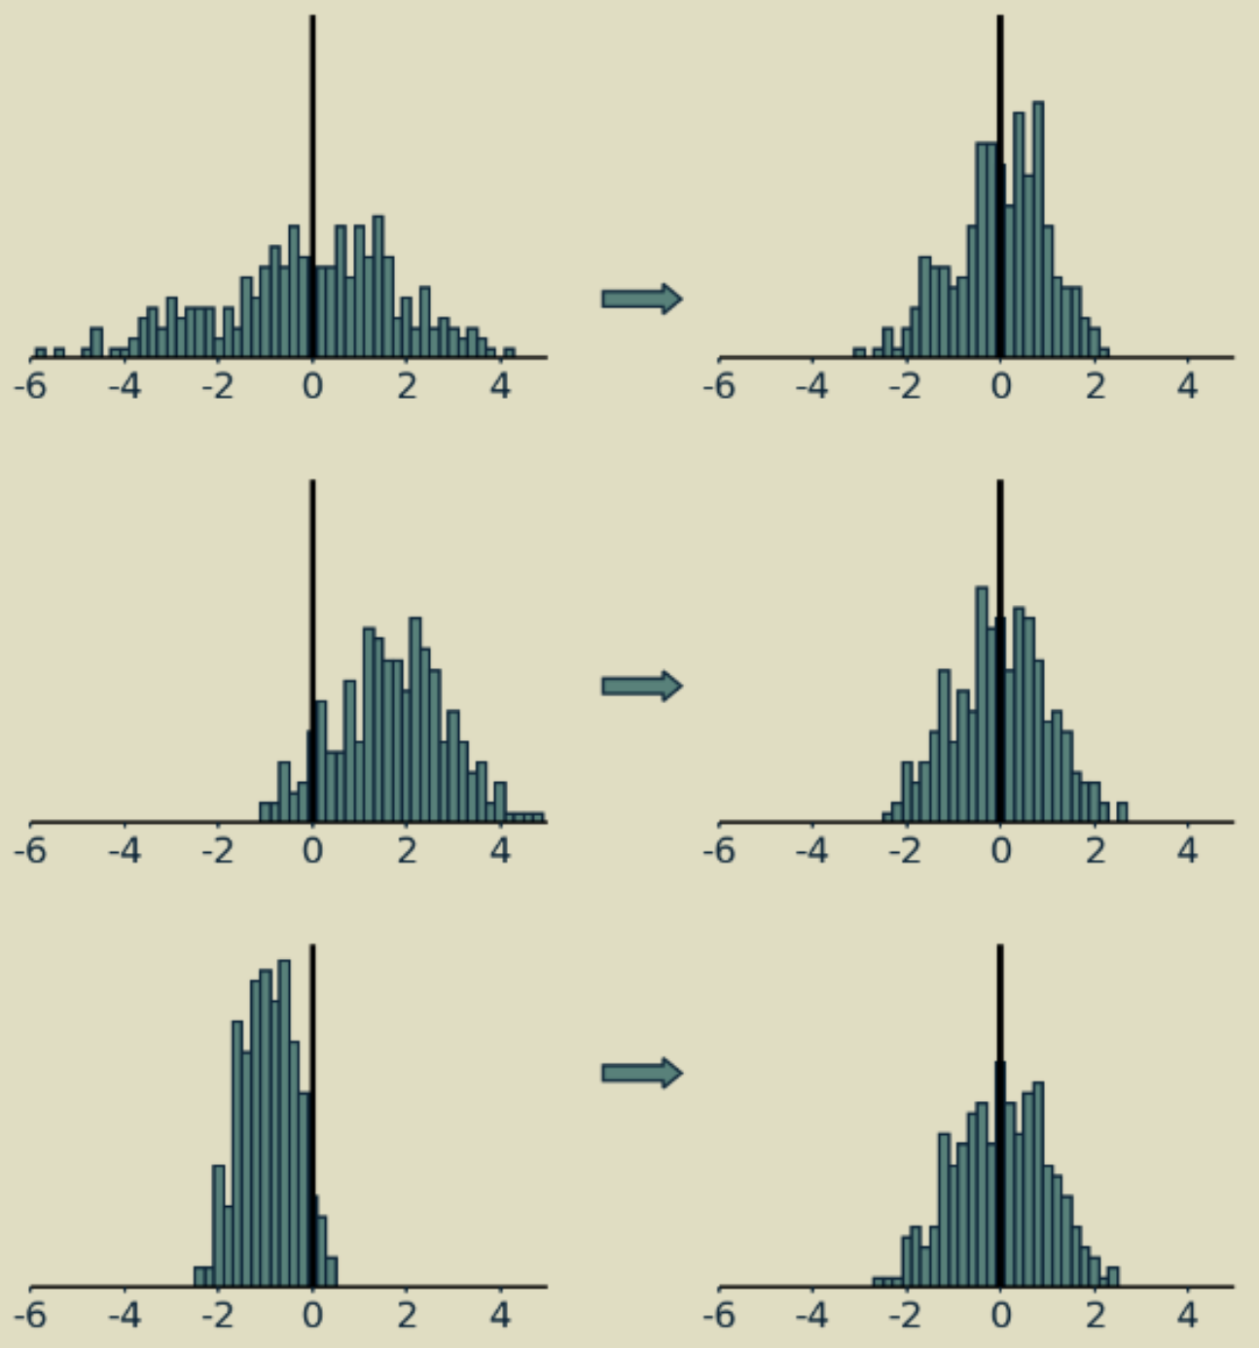
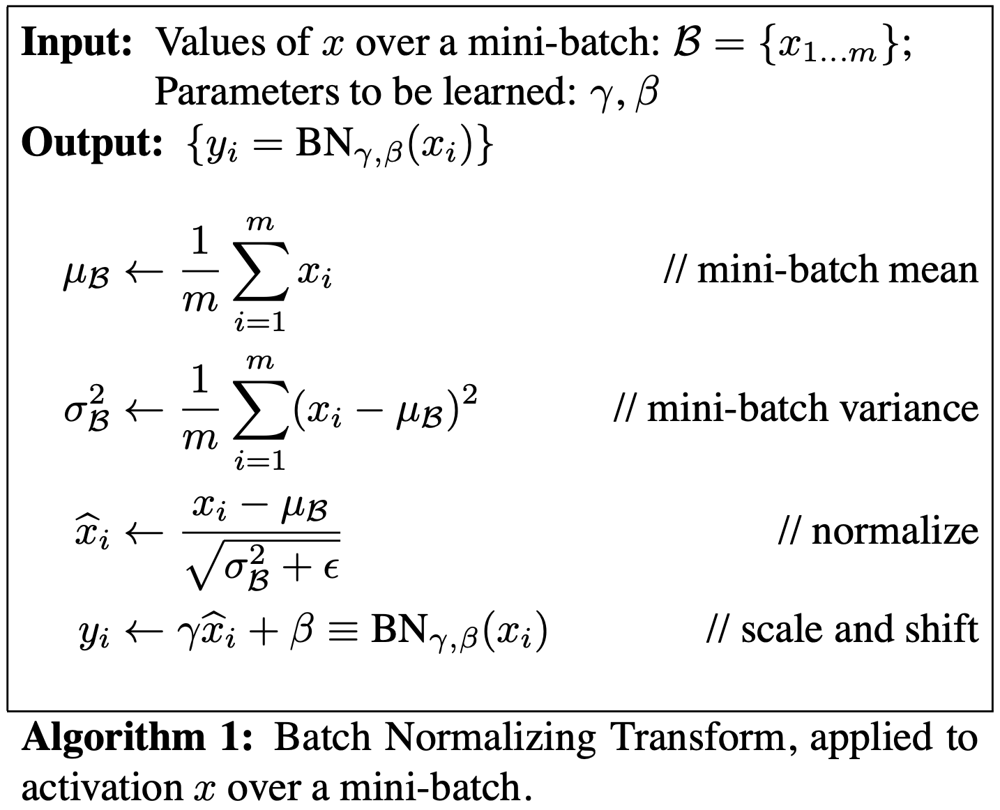
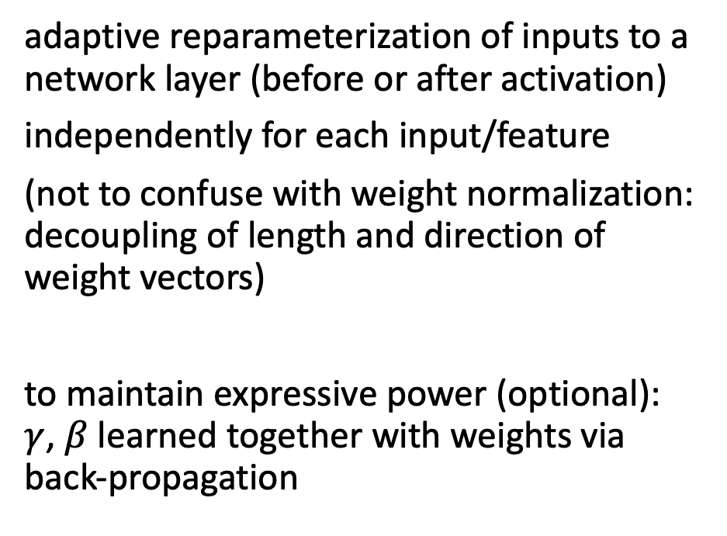
Batch Normalization
adaptive reparameterization of inputs to a network layer (before or after activation)
independently for each input/feature
(not to confuse with weight normalization: decoupling of length and direction of weight vectors)
to maintain expressive power (optional): $γ$, $β$learned together with weights via back-propagation
source
source

Slide 14
Benefits from Batch Normalization
allows higher learning rates
reduces importance of weight initialization
alleviates vanishing/exploding gradients
(implicit) regularization eﬀect: introducing both additive and multiplicative noise, sometimes making dropout (multiplicative noise) unnecessary
reason why batch normalization improves optimization still controversial
most plausible explanation: smoothening of loss landscape (similar to skip connections)

Slide 15
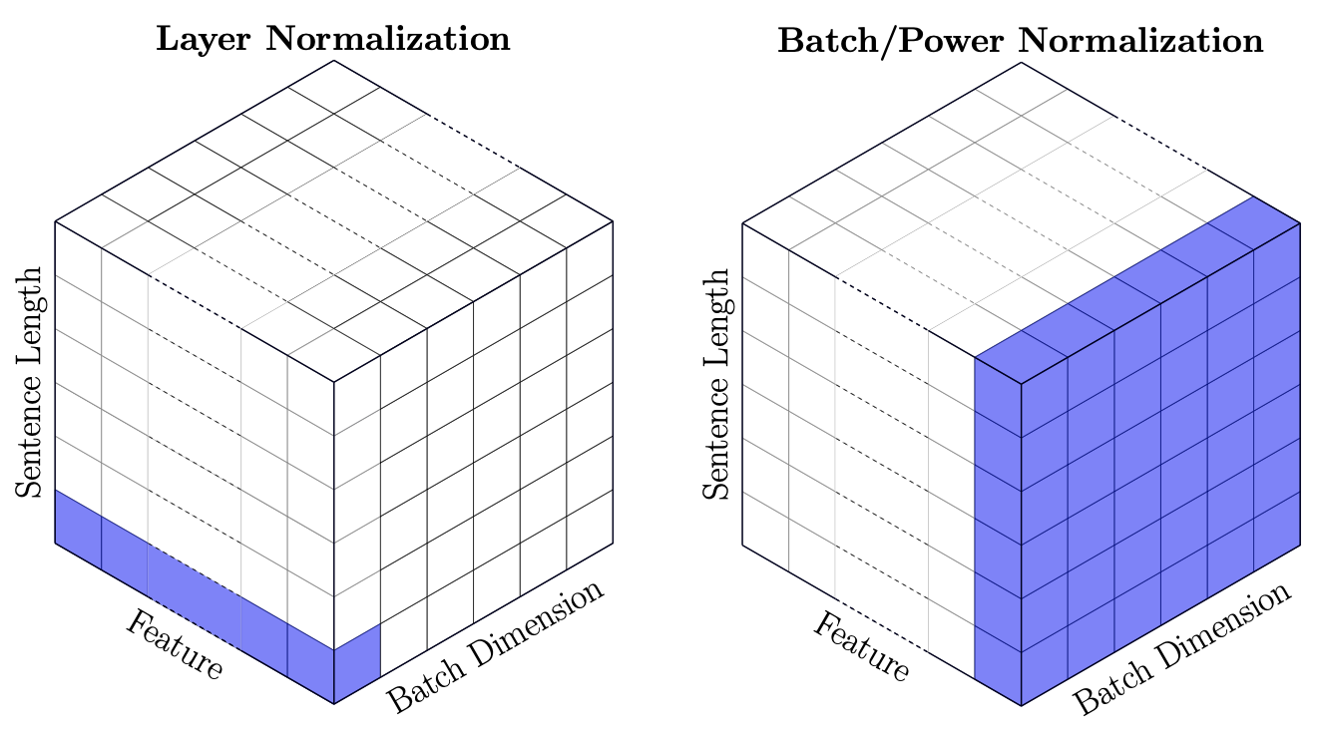
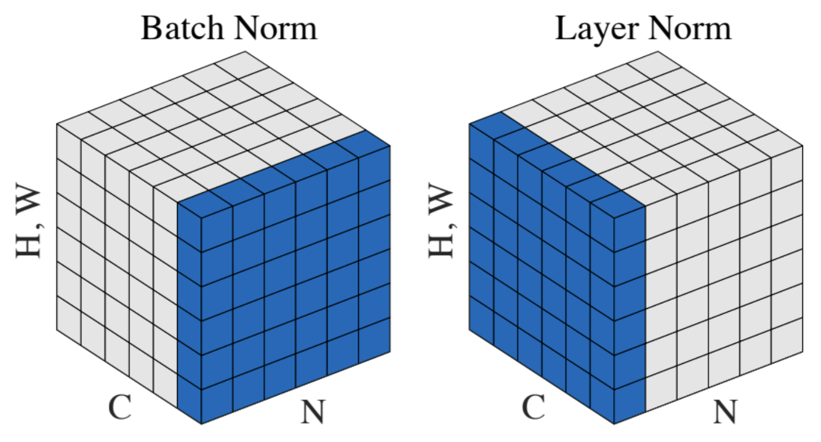
Layer Normalization
normalization over inputs/features, independently for each data sample
→ mean and variance shared over all hidden nodes of a network layer
batch norm often in computer vision (CNN), layer norm in NLP (variable-sized inputs)
transformer:
source
source

Slide 16
Comparison to Shallow Methods

Slide 17

Feature Engineering vs Feature Learning
shallow learning:
representation encoded in features
→ feature engineering
deep learning:
representation encoded in network
→ feature/representation learning
(hierarchy of concepts learned from raw data in deep graph with many layers)
source

Slide 18
Tabular vs Unstructured Data
deep learning methods dominate applications on unstructured data (like text or images), but not necessarily on tabular data
typical characteristics of tabular data difficult to handle for deep learning:
irregular patterns in target function (neural networks require piecewise continuous targets)
uninformative features
non-rotationally invariant data (linear combinations of features misrepresent the information)
tree-based models (e.g., gradient boosting) can naturally deal with these situations

Slide 19
Categorical Variables
tabular data usually heterogenous, often with sparse categorical variables (like color of an object)
→ need for an encoding for categorical variables
different possibilities:
ordinal encoding (introduces artificial order to unordered categories)
leave-one-out encoding (use mean of target for given category excluding current row, used in CatBoost)
one-hot encoding (can suffer from curse of dimensionality)
embeddings (can also alleviate issue of non rotationally-invariant data)

Slide 20
Embeddings

Slide 21




Vector Representations
embeddings: representation of entities by vectors
similarity between embeddings by, e.g., cosine similarity → semantic similarity
most famous application: word embeddings → associations (natural language processing)
but general concept: embeddings of (categorical) features (e.g., products in recommendation engines)
learned via co-occurrence (e.g., word2vec)
but also direction of difference vectors interesting (analogies):
source

Slide 22



Word Embeddings as Part of Language Model
language models contain embedding matrix as part of learned parameters
can be extracted and subsequently used as pre-trained embeddings for other task
typically several hundred dimensions for word vectors
trained on huge data sets (millions in vocabulary)
prominent task:
next-word prediction
source

Slide 23
Neural Language Models
using neural networks: learning distributed representation of words
self-supervised learning: sliding (with some sliding window) over text to generate training data set
learning of embeddings: kind of feature learning (dimensions of embeddings vectors)
contextually-meaningful embeddings can be learned by means of sequence models (RNN/LSTM, transformer)

Slide 24
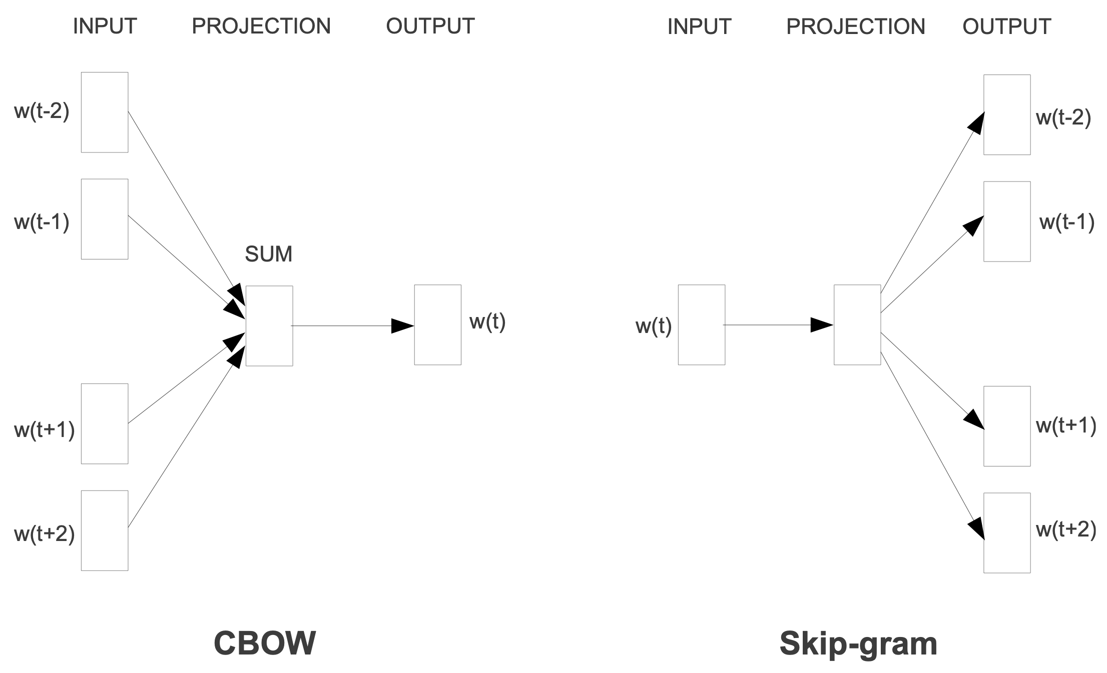

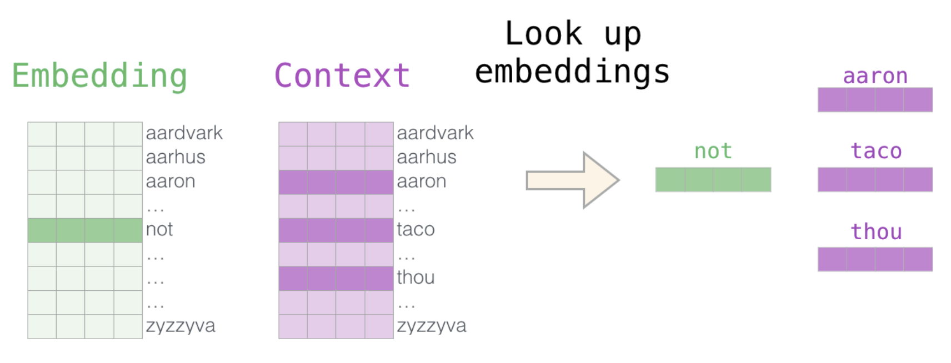
word2vec
focus on generating word embeddings, not entire language model → negative sampling:
use input and output words of language model as features, binary target if neighbors (dropping expensive projection to output vocabulary → much faster)
include random negative samples (samples of words that are not neighbors)
not a deep neural network (just single hidden layer)
“helper” matrix
Continuous Bag Of Words
source

Slide 25
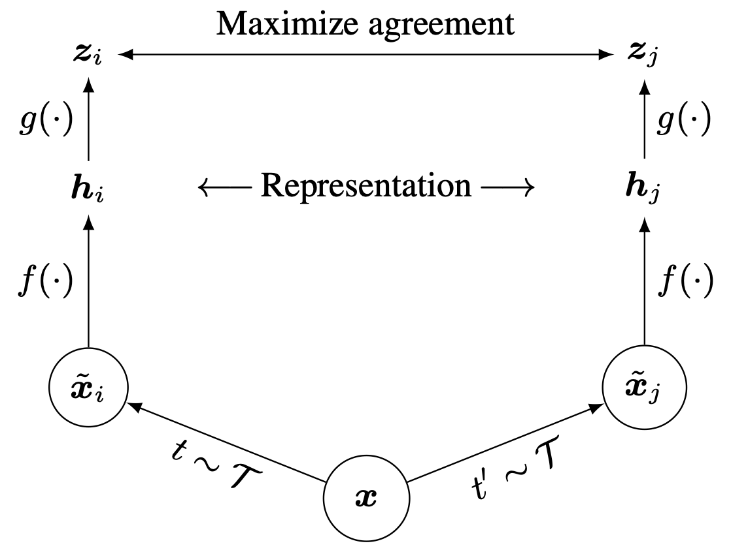
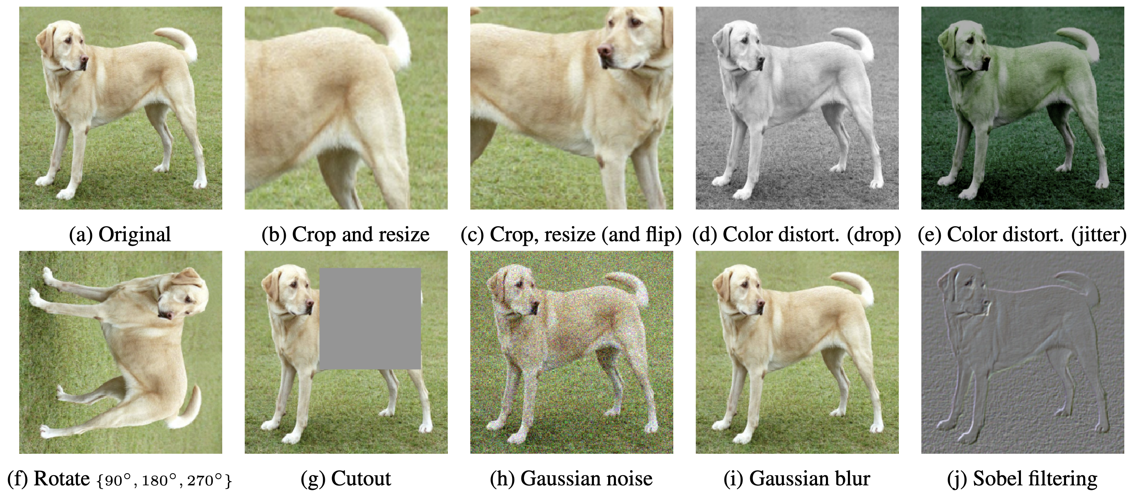
Contrastive Learning
goal: create embedding space in which similar samples are close to each other and dissimilar ones are far apart
often learned in a self-supervised way
examples:
natural language processing: word2vec
computer vision: SimCLR, SimCLRv2 (learning of image representations)
source

Slide 26
Autoencoders

Slide 27

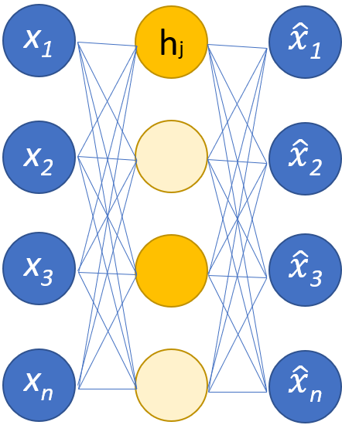
Representation Learning
autoencoders as prime example of representation learning
combination of
encoder: converting input data into diﬀerent representation (code)
decoder: converting learned representation back into original format
possibilities to avoid simple duplication:
undercomplete autoencoders: code with smaller dimension (less nodes) than input (generalized PCA: autoencoder is PCA if encoder and decoder are linear transformations)
sparse autoencoders: sparsity penalty to deactivate hidden nodes (e.g., with help from ReLU activation)
learned in the same way as feed-forward neural networks
from wikipedia

Slide 28
History: Unsupervised Pre-Training
breakthrough in effectiveness of deep learning training in 2006:
Deep Belief Networks introduced idea of greedily initializing each layer by unsupervised learning
(using an energy-based method called Restricted Boltzmann Machine)
→ commonly seen as actual starting point of deep learning wave
only later, ReLU activation functions (and other improvements) enabled effective deep learning without unsupervised pre-training
but unsupervised pre-training still beneficial in context of semi-supervised learning, using large amounts of unlabeled data

Slide 29
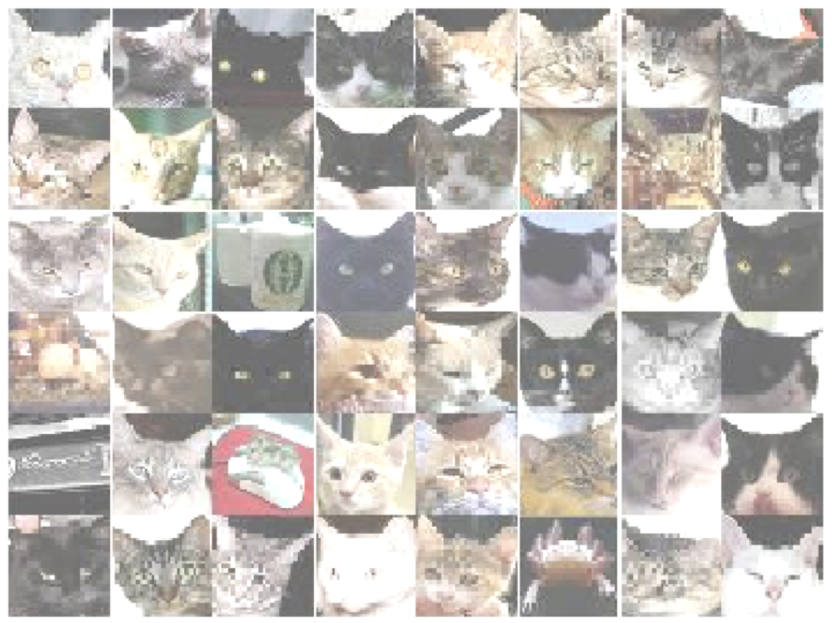
Stacked Autoencoders
besides dimensionality reduction, autoencoders can also be used (instead of Restricted Boltzmann Machines) for unsupervised pre-training
→ feature learning (internal distributed representations, high-level abstractions of input data), initializing weights in region near a good local minimum
stacking of autoencoders (or RBMs) → industry adoption:
object recognition (cat paper)
speech recognition in industry
stimuli for cat neuron:
source

Slide 30
Recurrent Neural Networks (RNN)

Slide 31
Sequential Structures
speech recognition, natural language processing, time series, …
problem: need to generalize across different points in time (or multiple positions of words within a sentence) and learn from context
idea: parameter sharing across different parts of model
CNNs apply parameter sharing (convolutions) on grid-like structures (including 1-D grids like time series or speech), but this is limited to neighboring inputs (per layer).
→ need for approach to learn sequential structures (process input as stream, e.g., speech, rather than one batch, e.g., image)

Slide 32
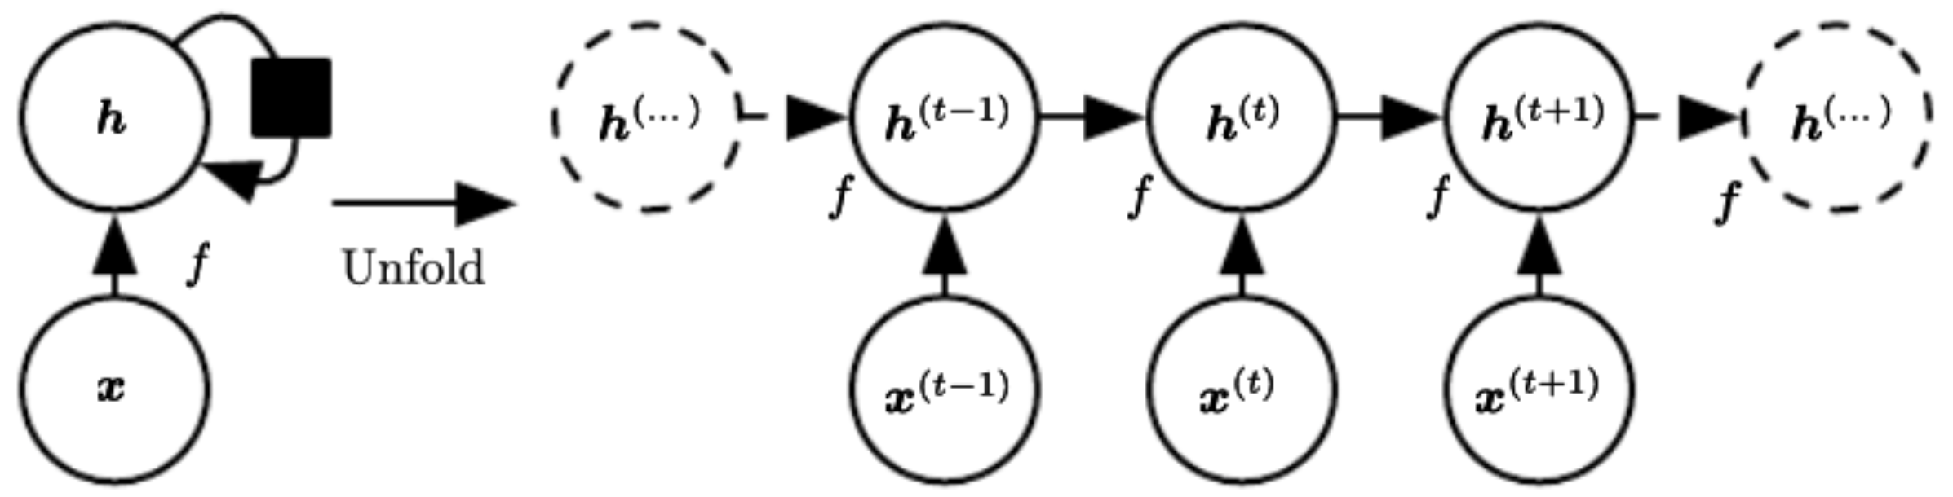
Back-Propagation through Time
RNN: output of node directed back to input
different kind of depth: one recurrence for each sequential step (e.g., word)
activation of recurrent nodes at that point in time
interaction with delay of single time step
computational graph with repeated pieces:
hidden layer: several recurrent neurons
input layer: e.g., one-hot encoded words or embeddings
single model operating on all time steps
source

Slide 33
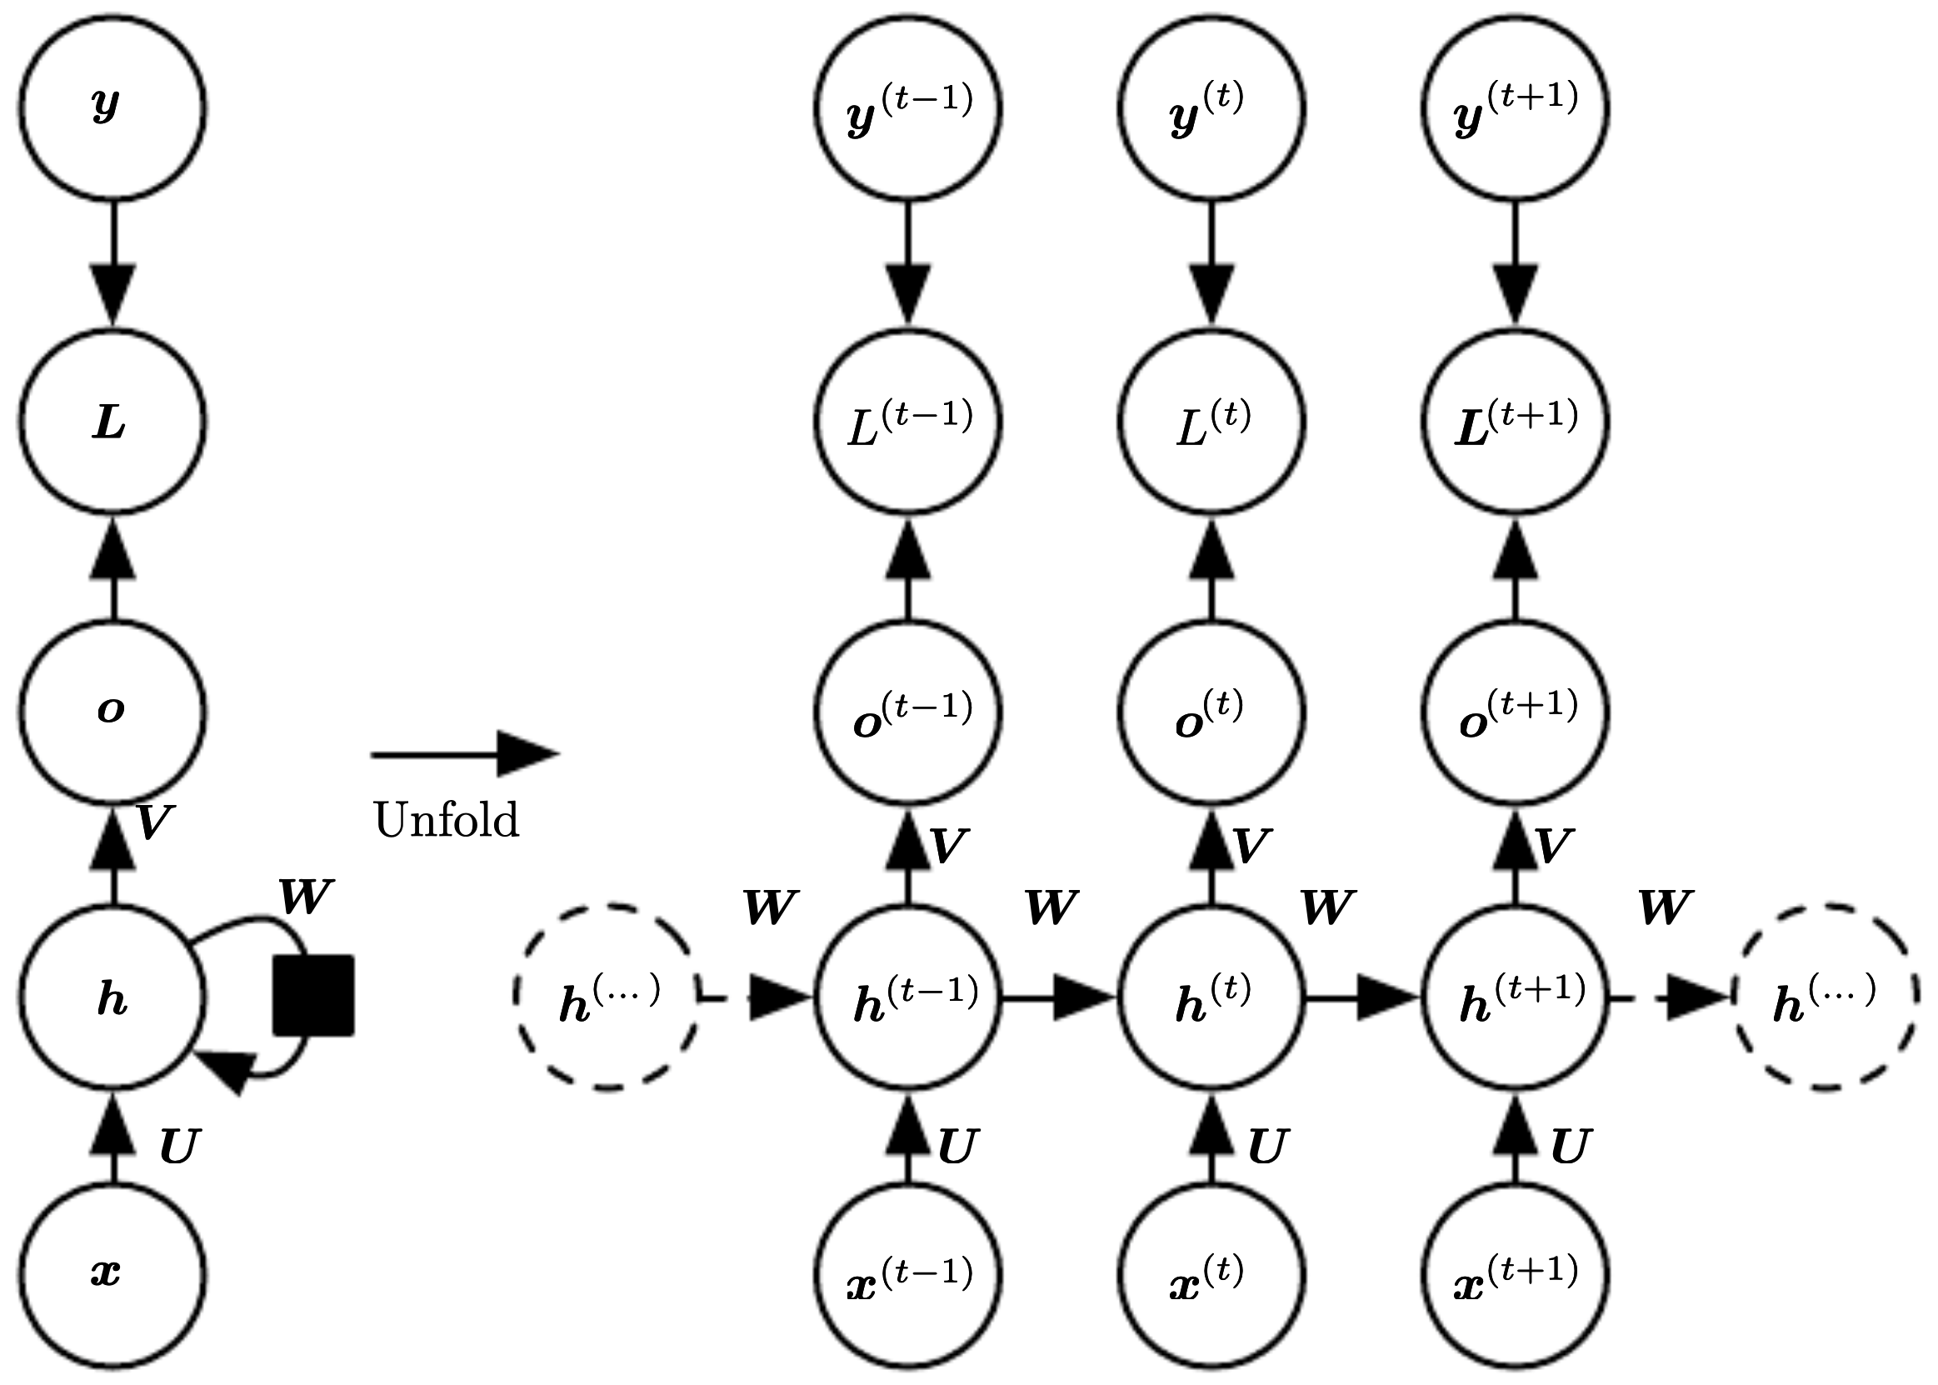
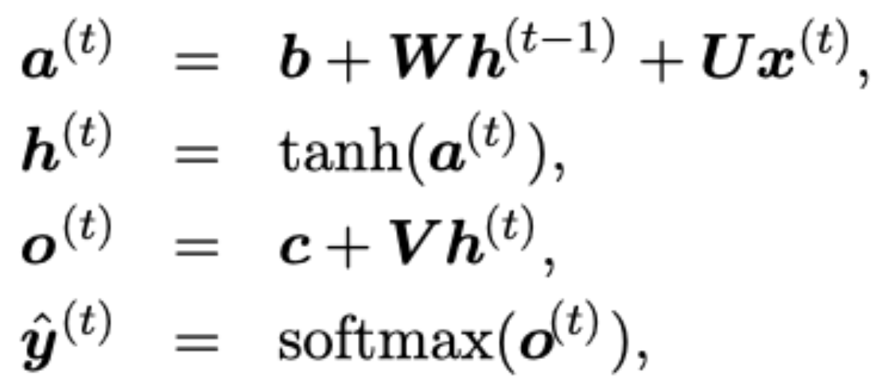
Weight Sharing across Time
example: input-output mapping at each time step with recurrent hidden nodes
total loss for sequence: sum of losses over time steps
Markov dependence on previous hidden state
more popular than ReLU here (exploding gradients)
discrete outputs
parameter/weight sharing over time
source

Slide 34
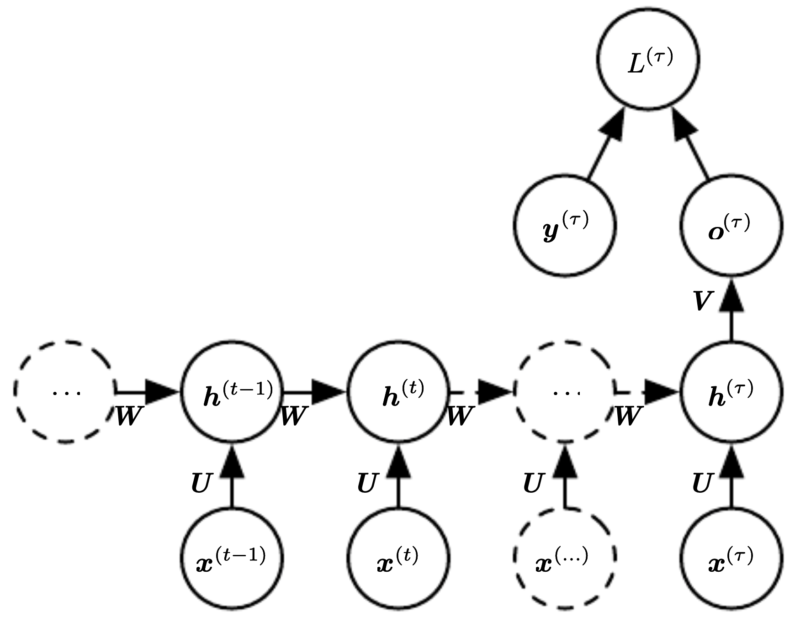
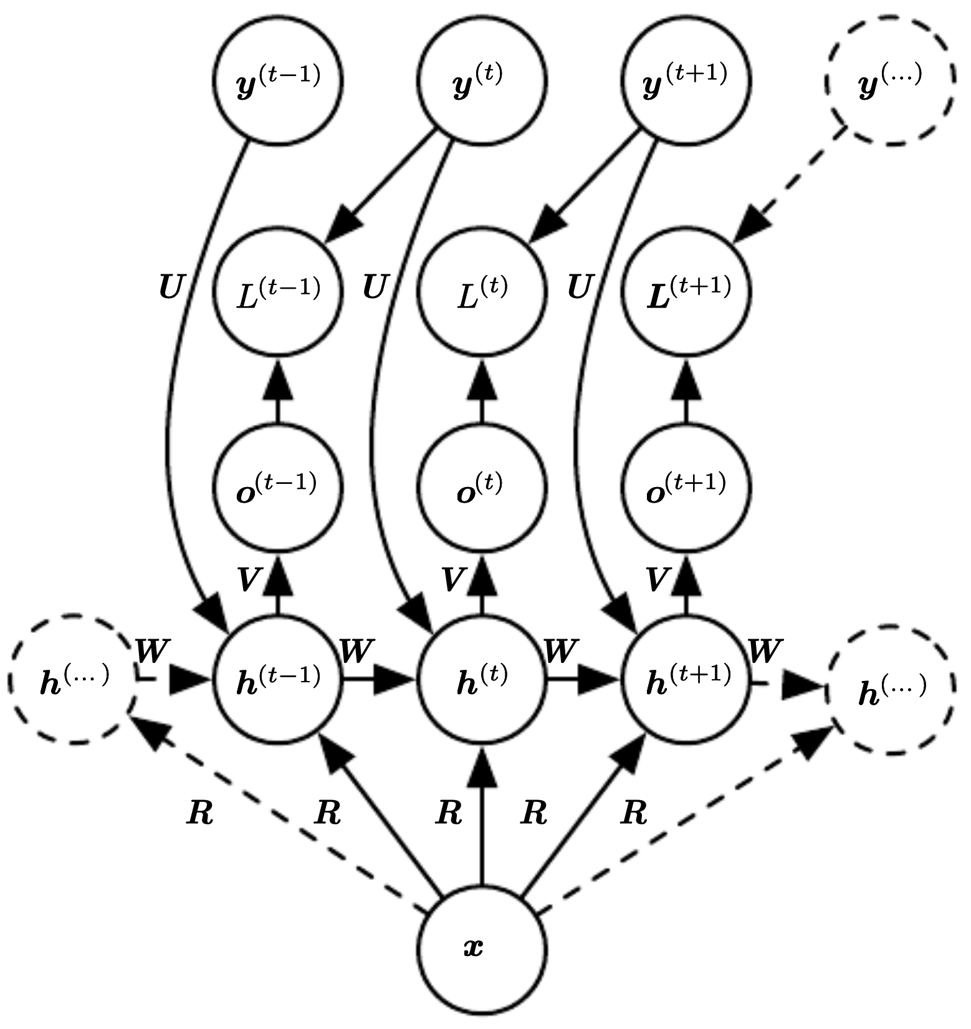
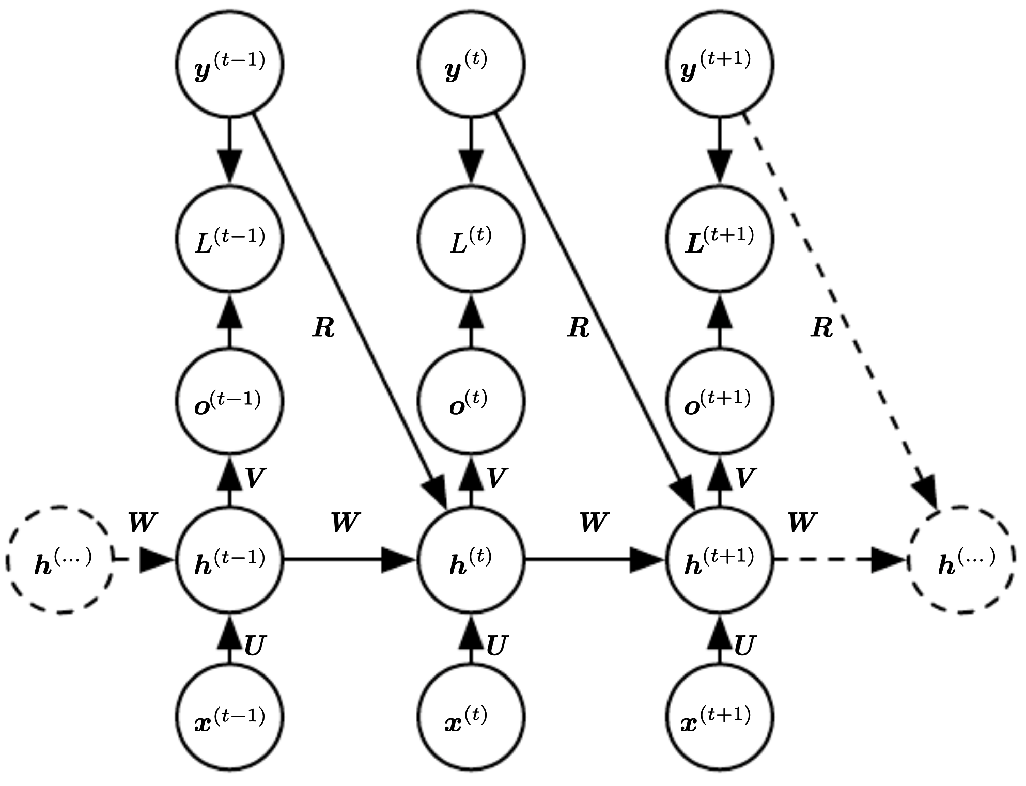
Further Examples
summarization of sequence:
image captioning:
conditional sequence:

Slide 35

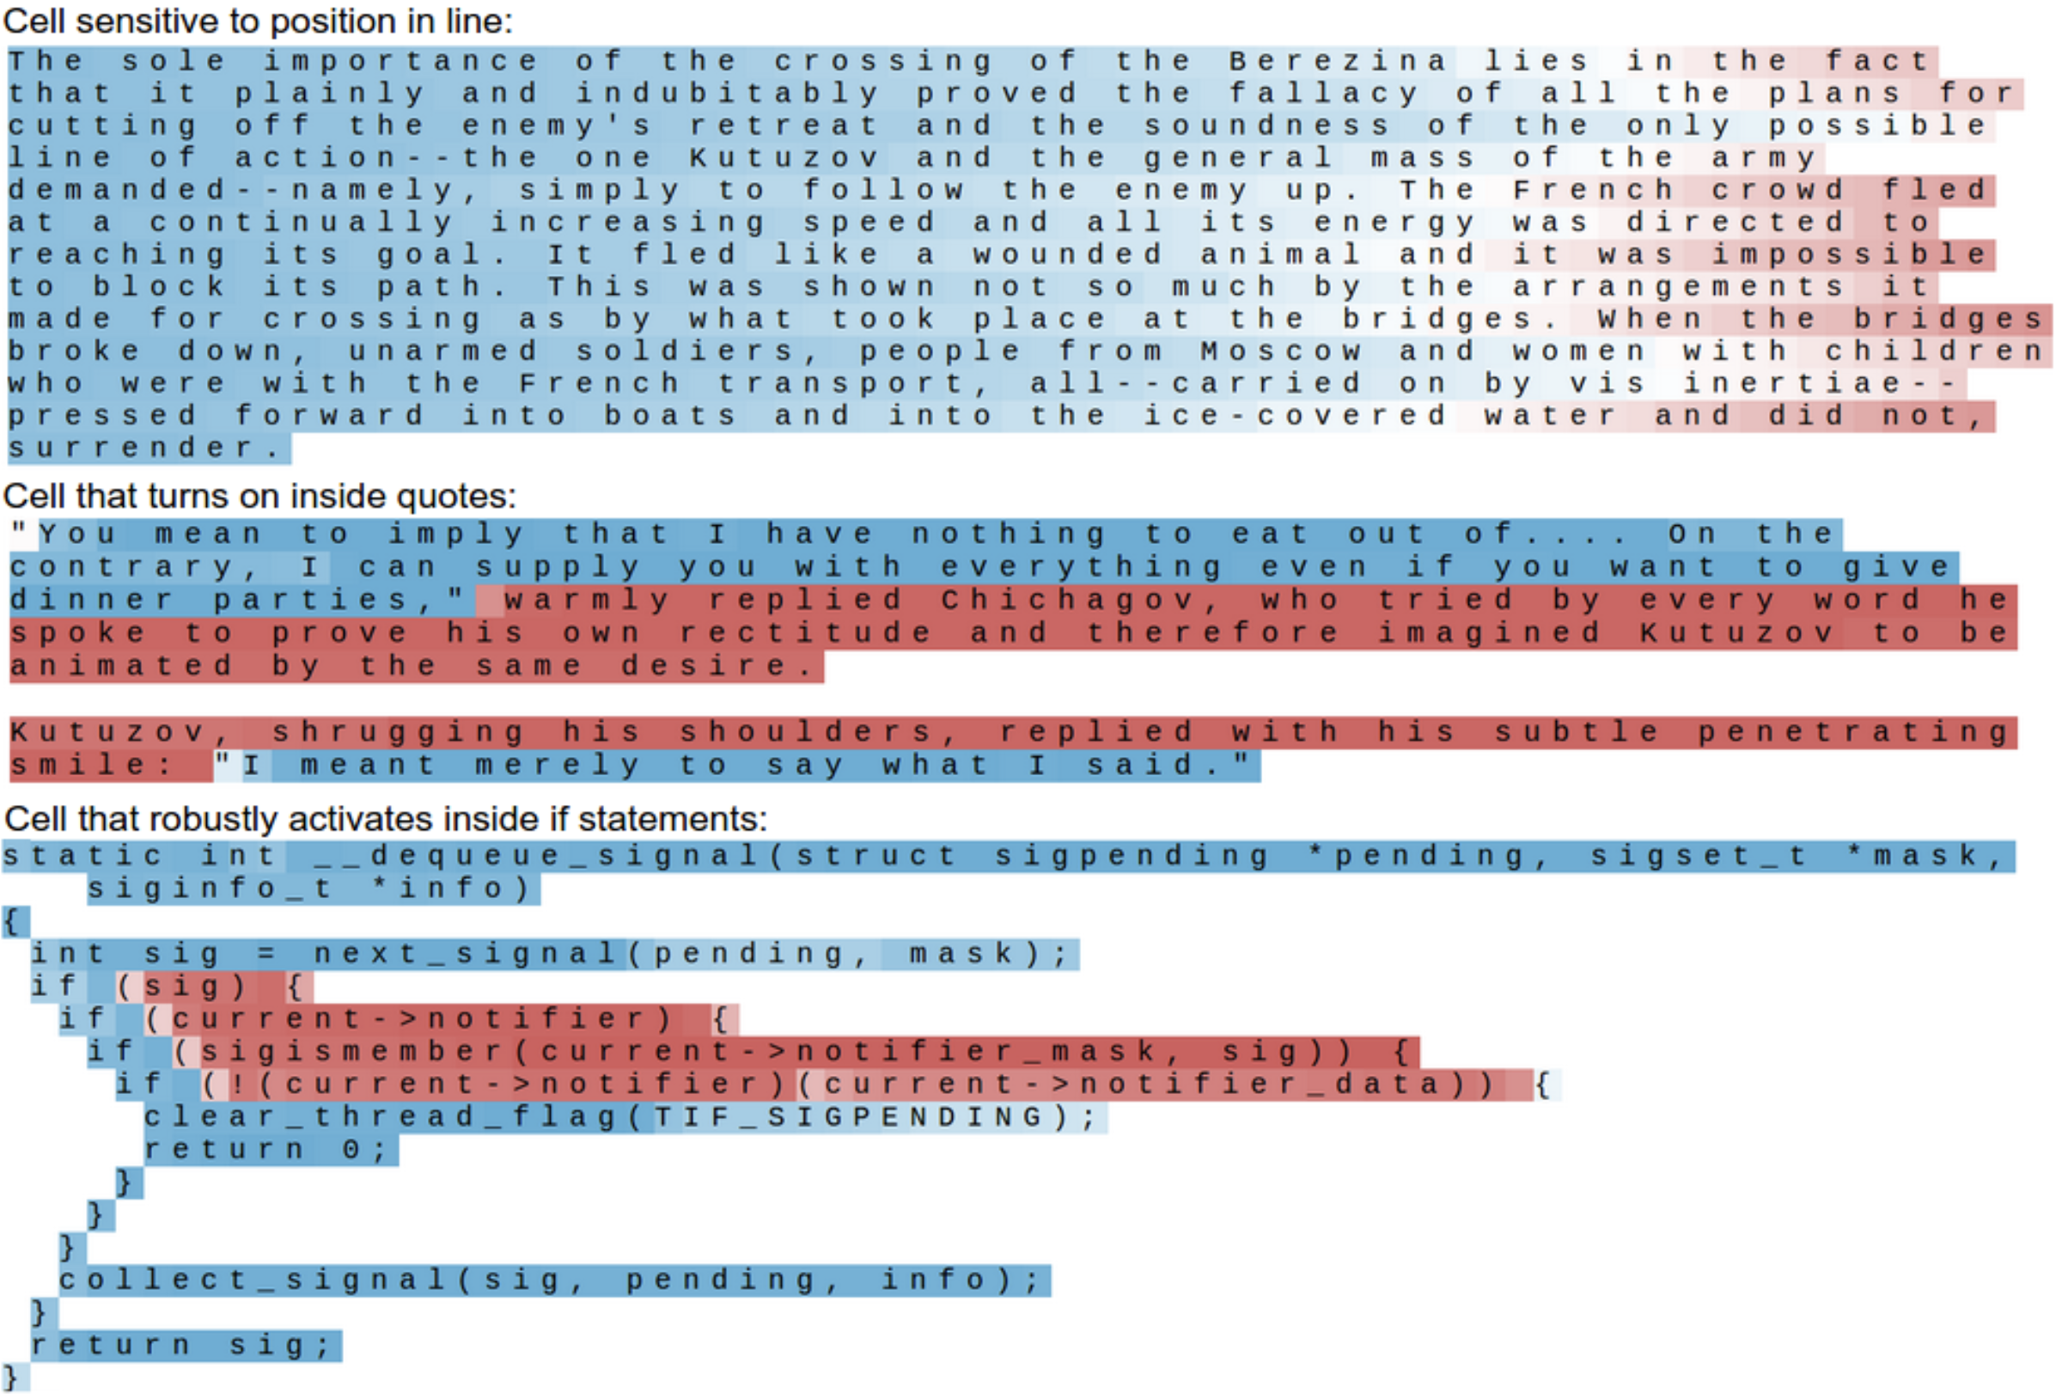
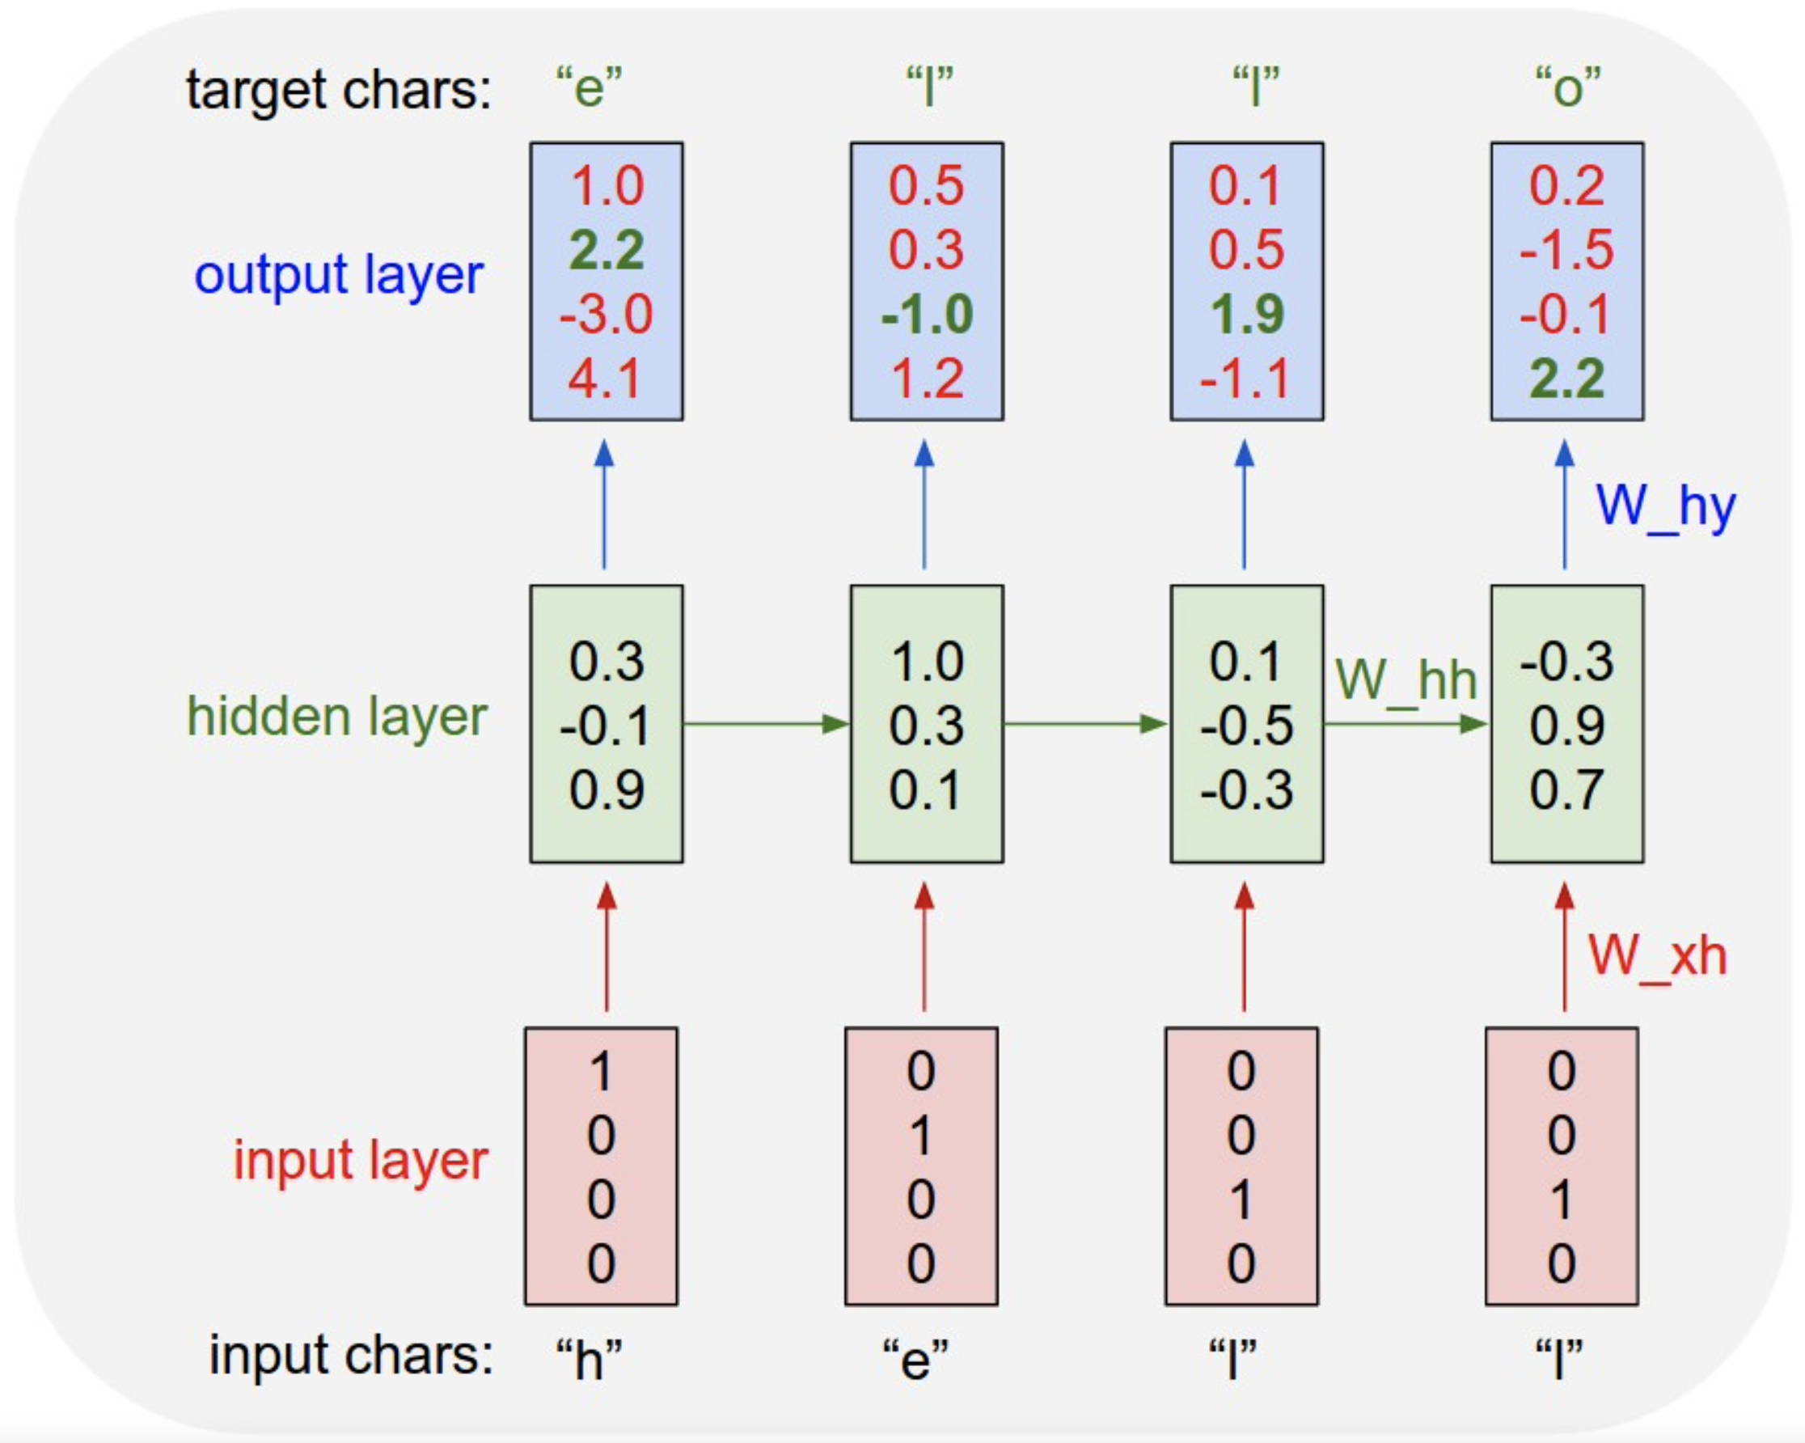
Visualization
neuron getting excited inside URLs (excited, not excited):
next character prediction
high/low activation:
source

Slide 36
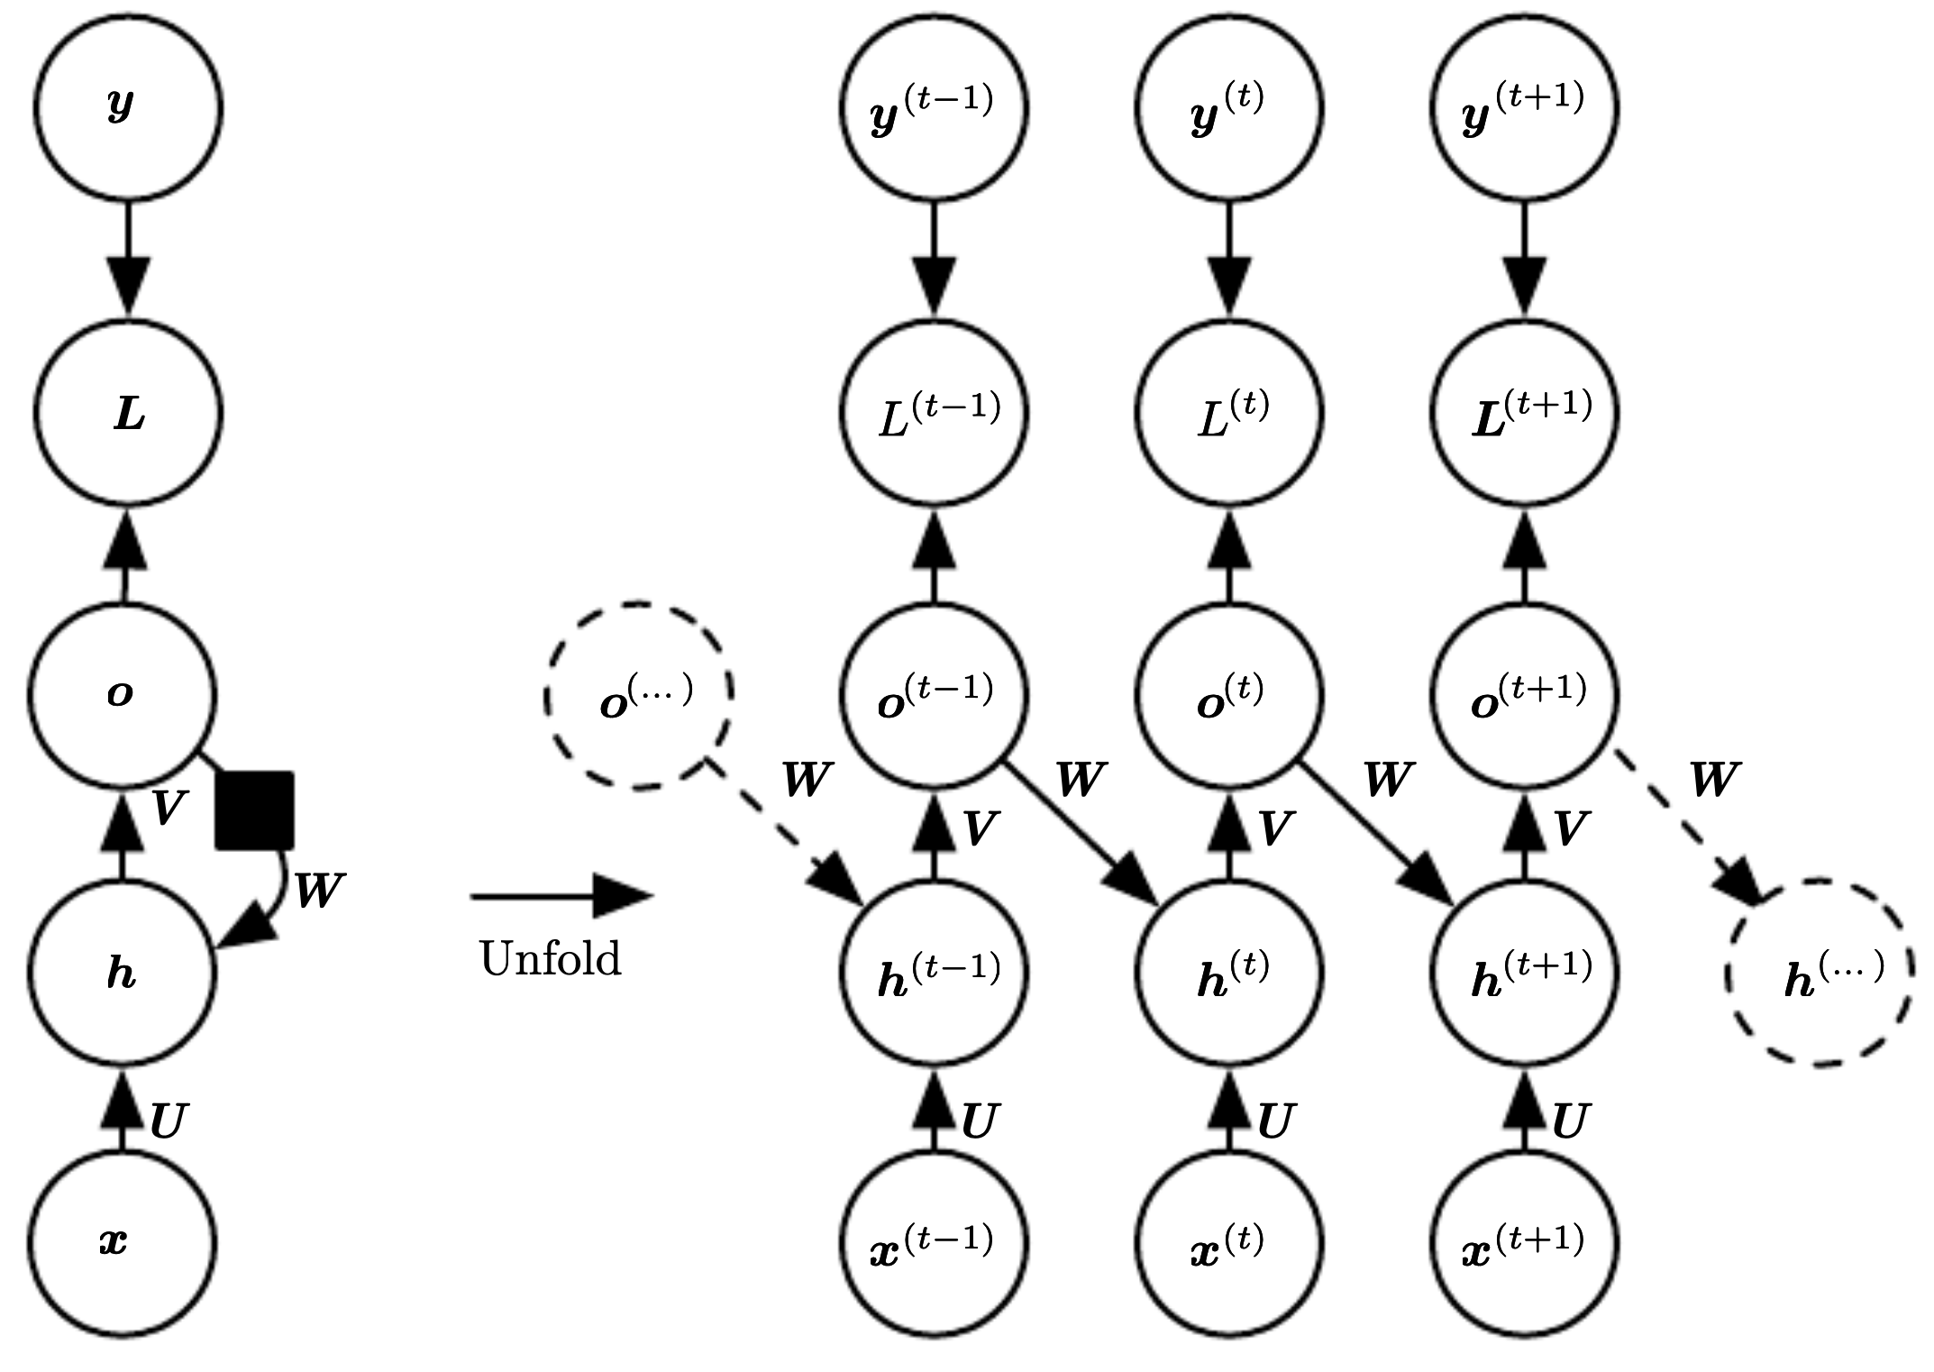
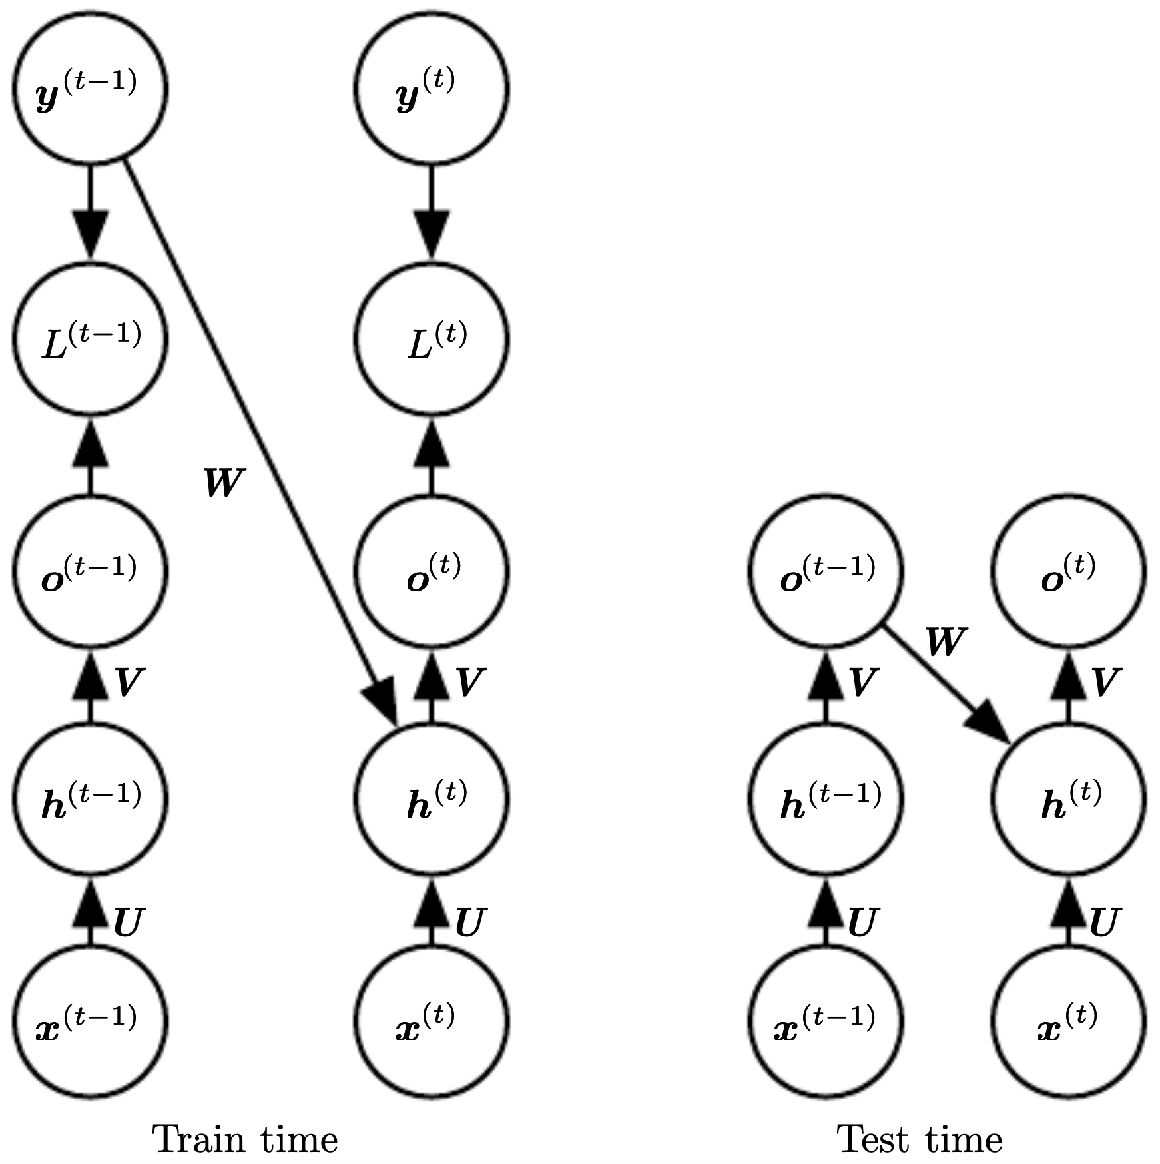
Teacher Forcing
for feedback from output to hidden layer: instead of feeding model output back into itself, use target values directly
source

Slide 37
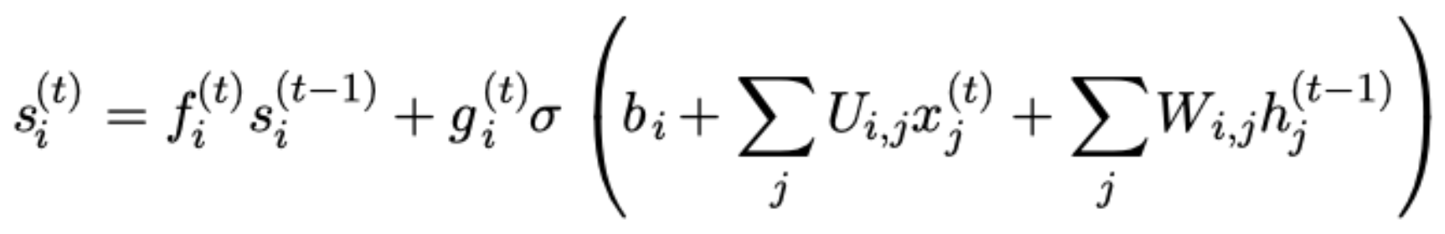
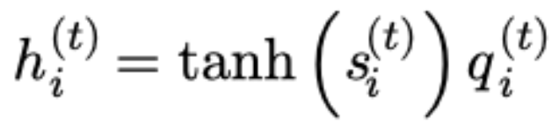
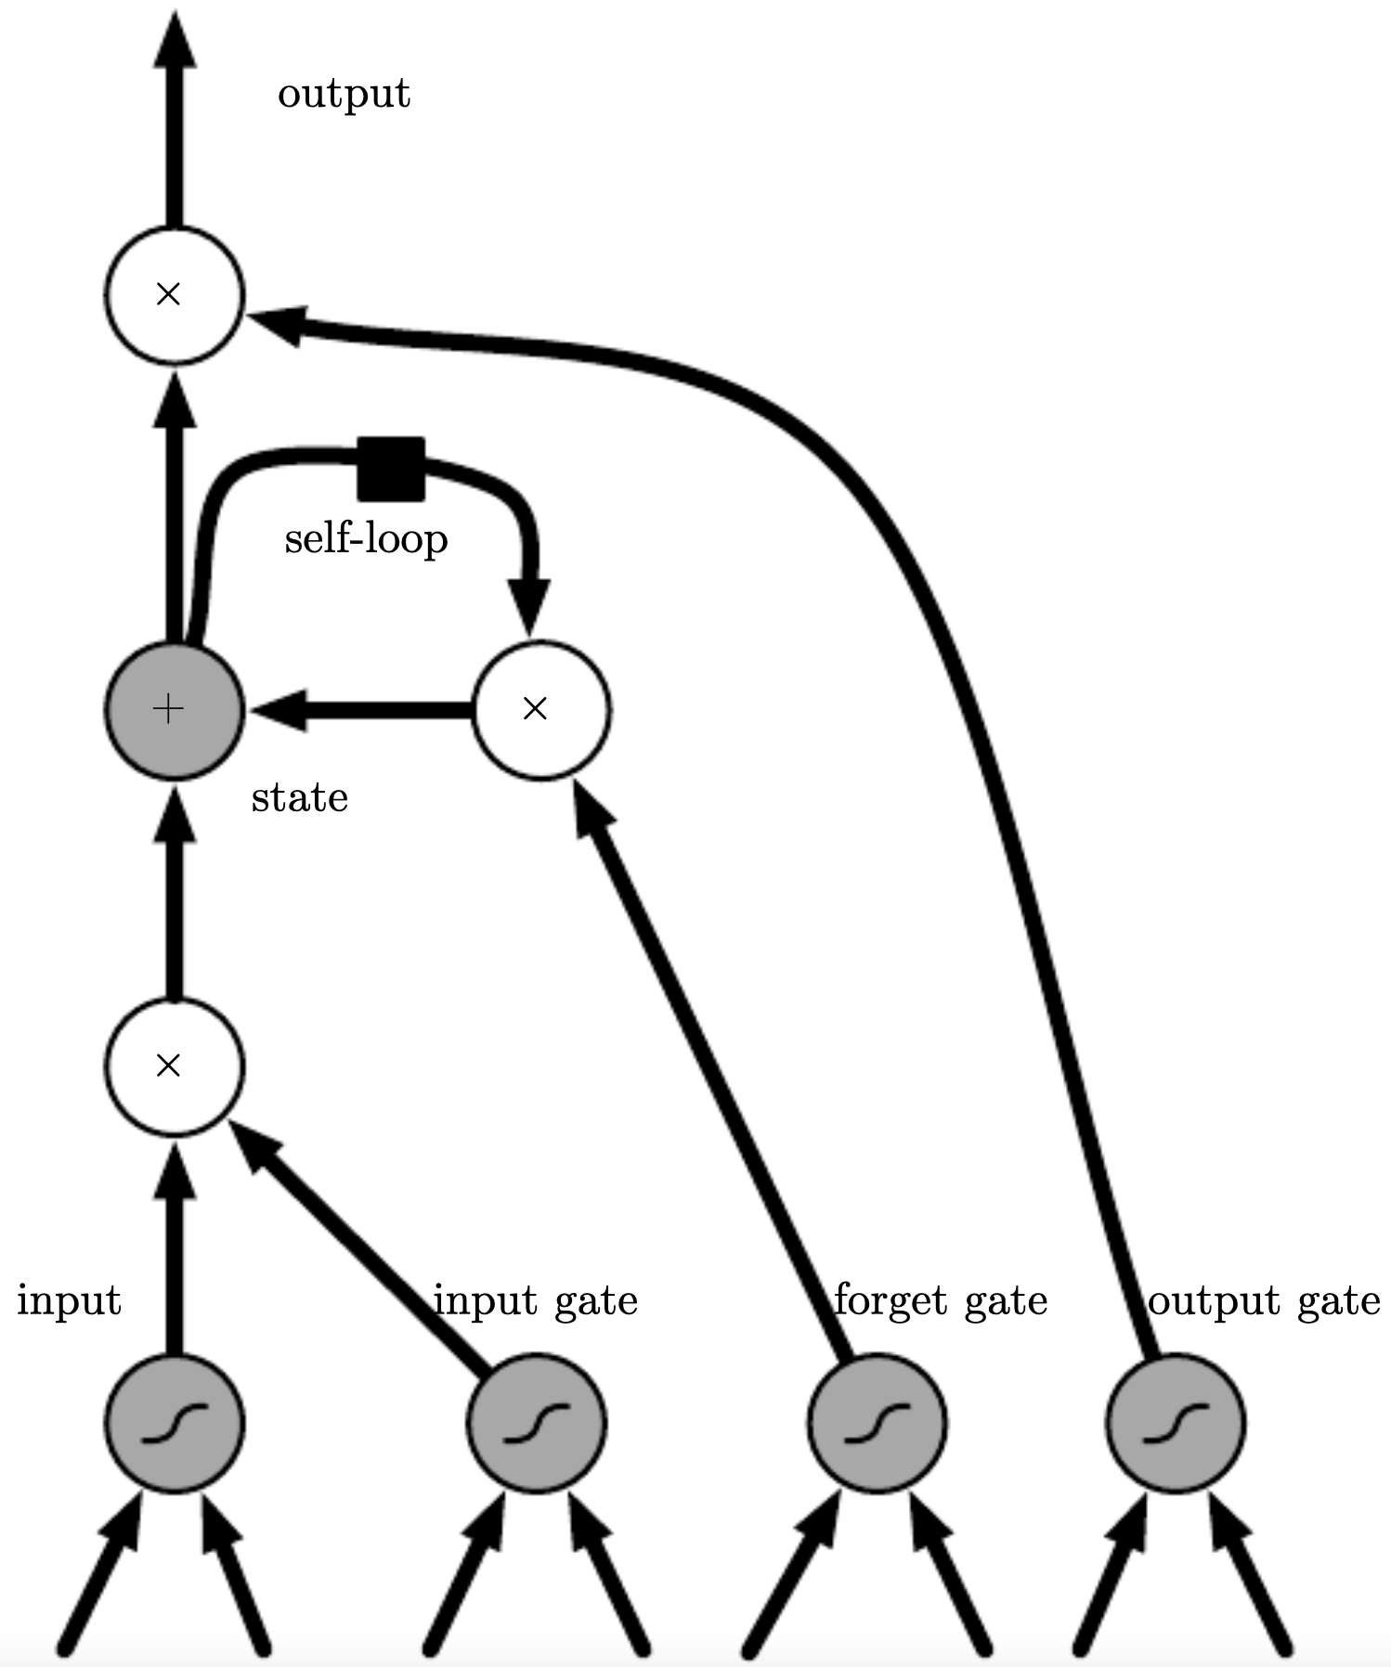
Gated RNNs
long-term memory: weights
short term memory: activation patterns
issue with long chain of gradients through recurrences: vanishing (mainly) and exploding gradients in back-propagation
→ need to focus on important sequence elements
replace usual recurrent hidden nodes with long short-term memory (LSTM) cells with internal recurrence (self-loop)
linear self-loop in addition to outer recurrence of RNN: error carousel preserving (→ long) short-term memory (i.e., activation patterns)
sigmoid activations with independent weights for input, forget, and output gates
other prominent gated RNN: gated recurrent unit (GRU)
source

Slide 38
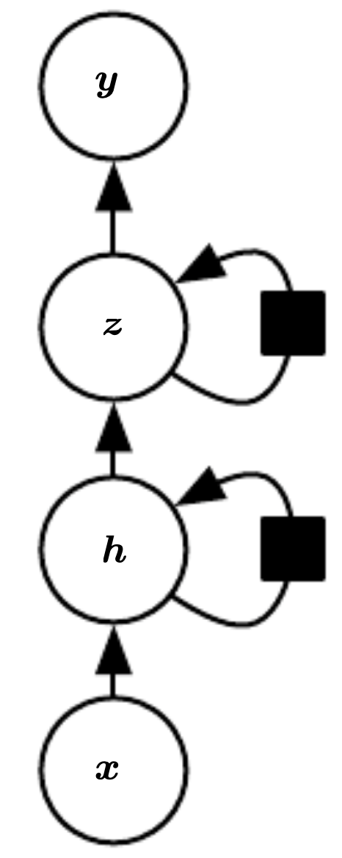
Issues with RNNs
especially LSTMs very computationally expensive (with lots of parameters)
transfer learning (using pre-trained network layers on new task, e.g., popular for CNNs) difficult
(hierarchical) representation learning: go deep by stacking several layers of recurrent nodes (e.g., important for speech recognition) → worsening efficiency even more
(self-)attention and transformers to the rescue …
source

Slide 39
Literature
papers:
Deep Learning overview
ResNet
A Neural Probabilistic Language Model
word2vec
training of Deep Belief Nets
blogs:
The Illustrated Word2vec
Karpathy on RNNs

Slide 40
Black-Box Models
To build trust in AI systems, individual predictions/actions need to be fully transparent, i.e., explainable.
Unfortunately, complex models like deep learning methods are difficult to interpret.
→ need for model-agnostic methods to explain black-box models
examples: local surrogates (LIME), Shapley values (SHAP)
overview

